Slide 1
Anatomy and Physiology
Bone Identification

Slide 2
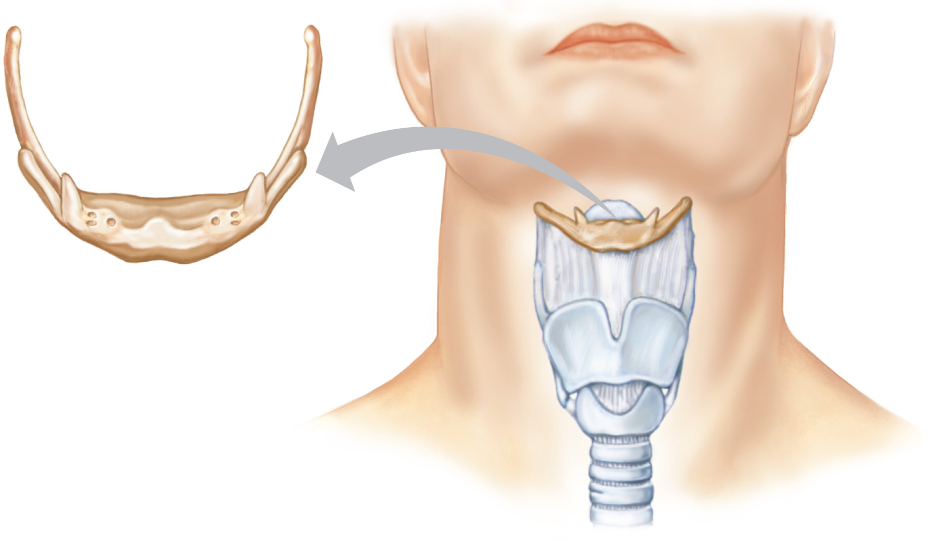
Hyoid bone
Hyoid bone

Slide 3
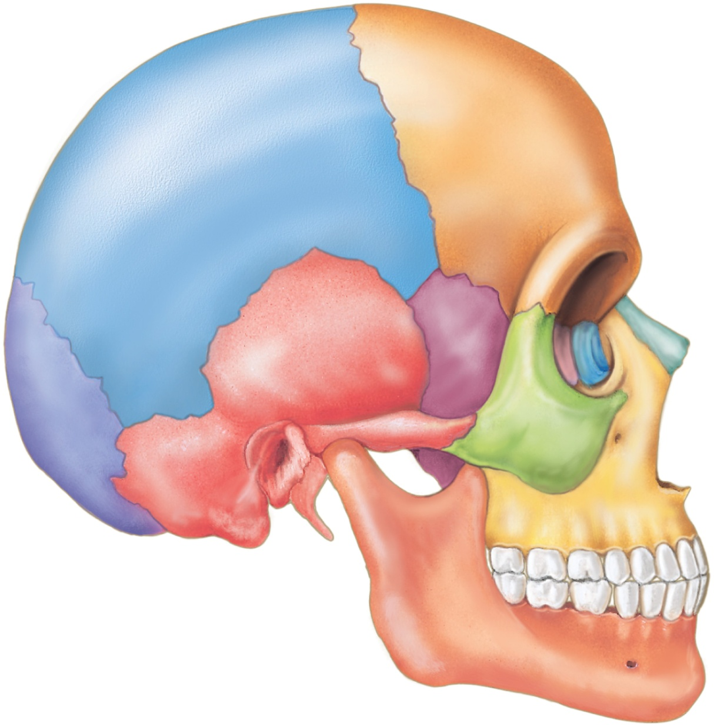
Parietal bone
Coronal suture
Frontal bone
Squamous suture
Sphenoid bone
Lambdoid suture
Ethmoid bone
Occipital bone
Lacrimal bone
Temporal bone
Nasal bone
Zygomatic bone
External acoustic meatus
Mastoid process
Maxilla
Mandibular condyle
Styloid process
Mental foramen
Mandible
Coronoid process

Slide 4
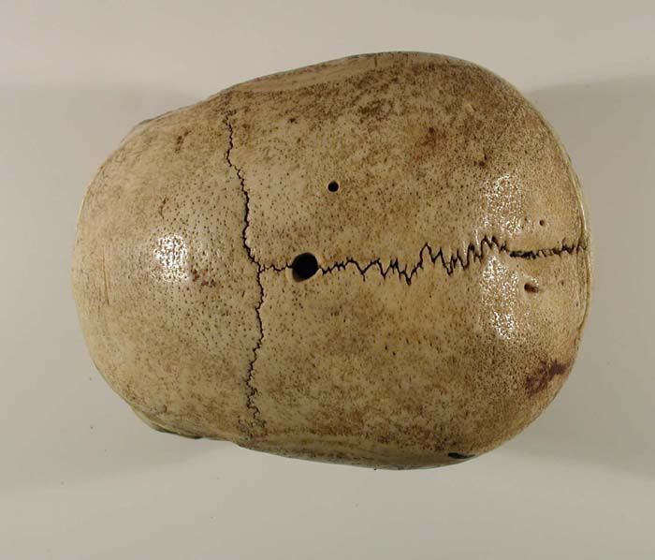
Sagittal suture
Coronal suture
Frontal Bone
Parietal Bones

Slide 5
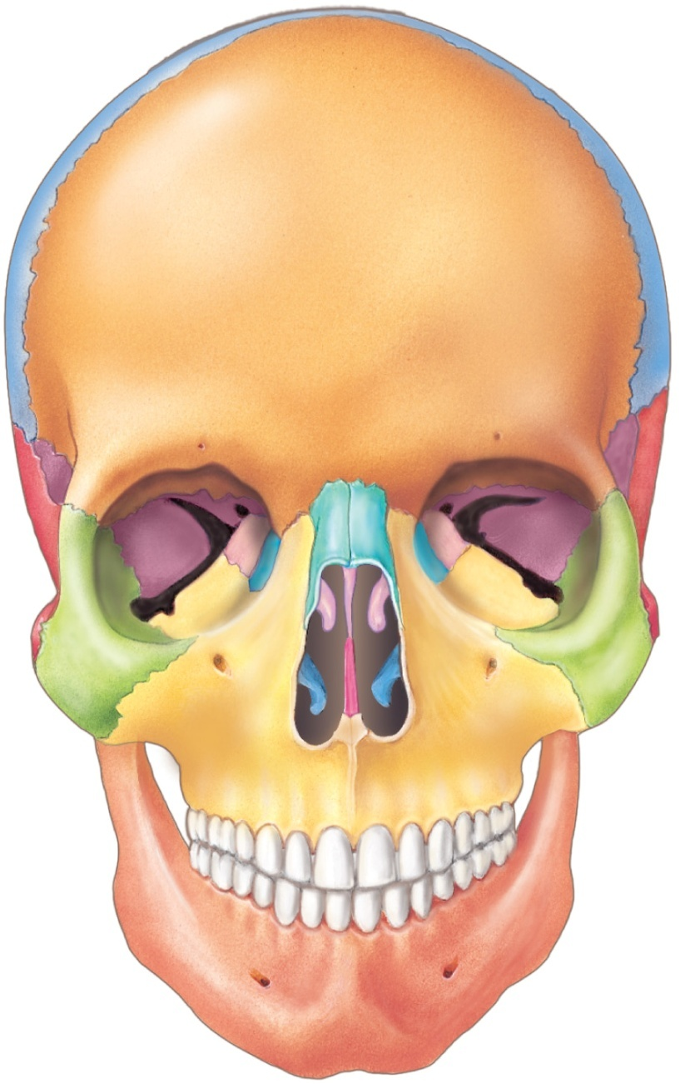
Parietal bone
Frontal bone
Coronal suture
Lacrimal bone
Ethmoid bone
Squamous suture
Sphenoid bone
Temporal bone
Nasal bone
Perpendicular plate
of the ethmoid bone
Sphenoid bone
Zygomatic bone
Vomer bone
Maxilla
Mandible
Mental foramen

Slide 6
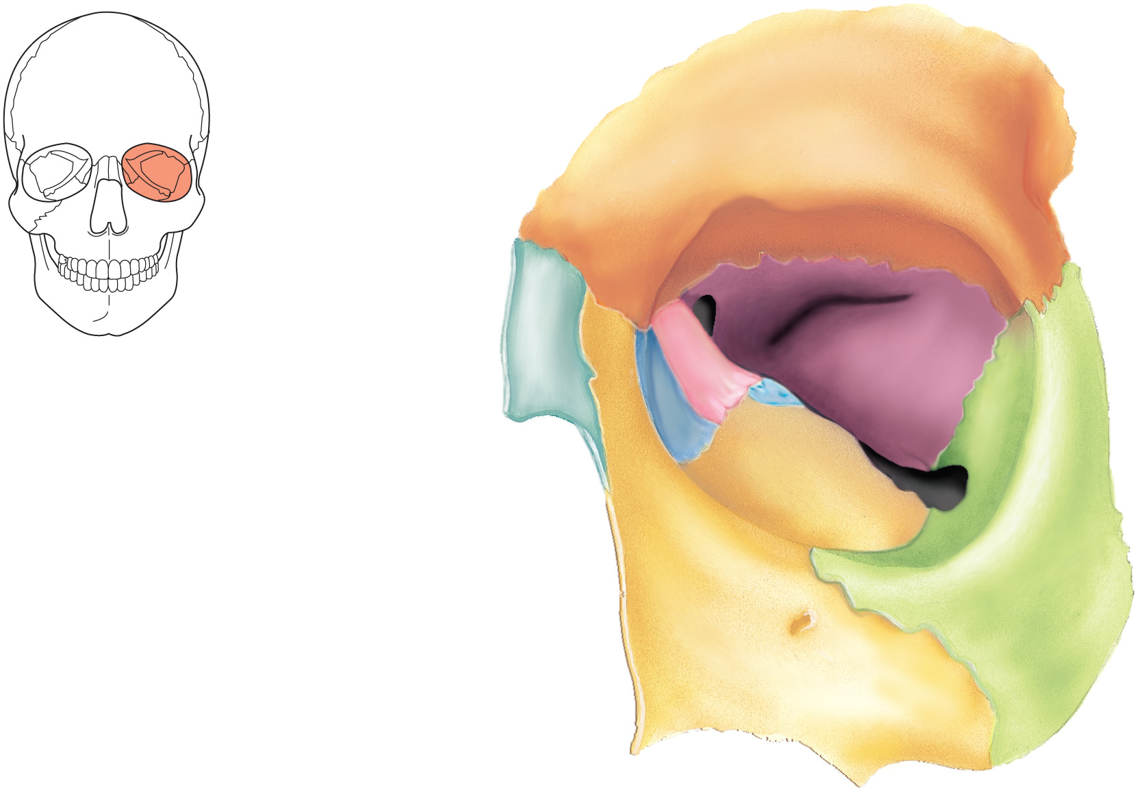
Frontal bone
Nasal bone
Sphenoid bone
Ethmoid bone
Palatine bone
Lacrimal bone
Maxilla
Zygomatic bone

Slide 7
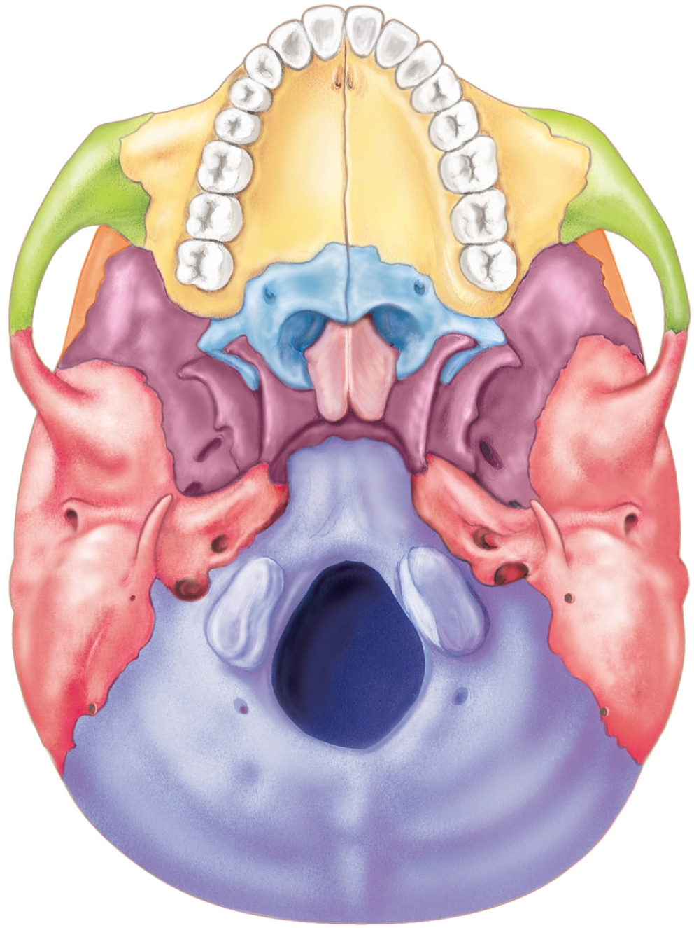
Palatine process of maxilla
Zygomatic bone
Frontal bone
Palatine bone
Sphenoid bone
Zygomatic arch
Vomer bone
Mandibular fossa
Styloid process
External acoustic meatus
Occipital condyle
Foramen magnum
Lambdoid suture
Temporal bone
Occipital bone

Slide 8
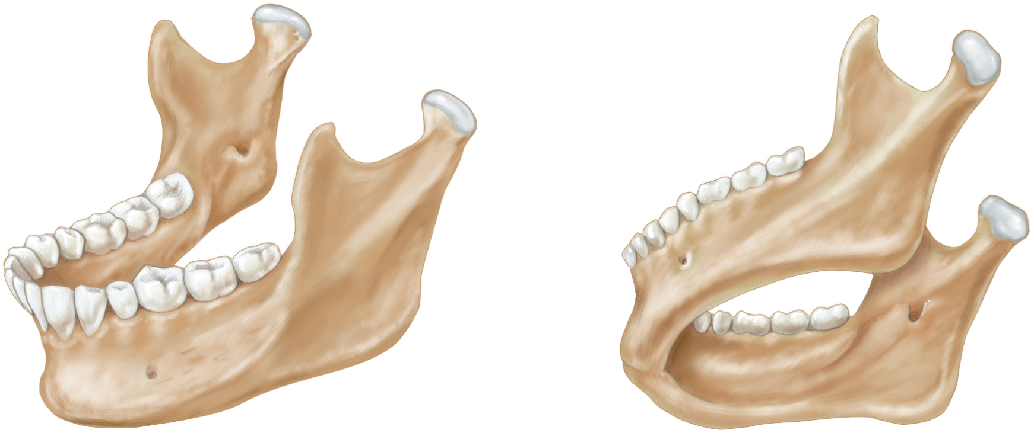
Coronoid
process
Coronoid process
Mandibular
foramen
Mandibular condyle
Ramus
Mandibular
foramen
Mental foramen

Slide 9
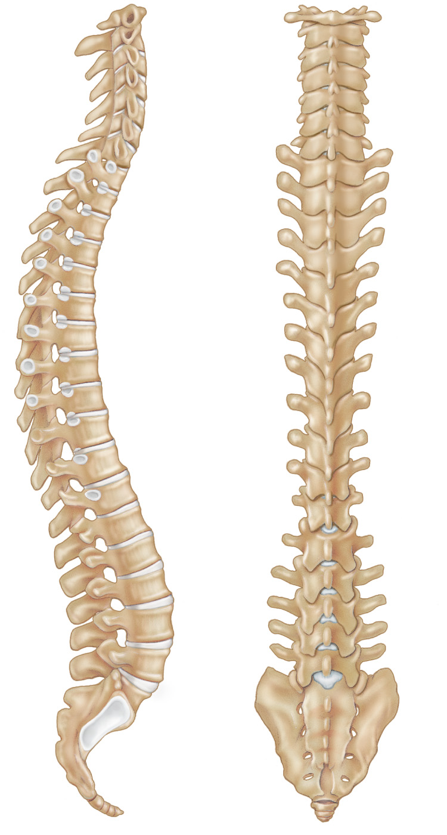
Cervical
vertebrae
Vertebra
prominens
Thoracic
vertebrae
Intervertebral
discs
Intervertebral
foramina
Lumbar
vertebrae
Sacrum
Coccyx

Slide 10
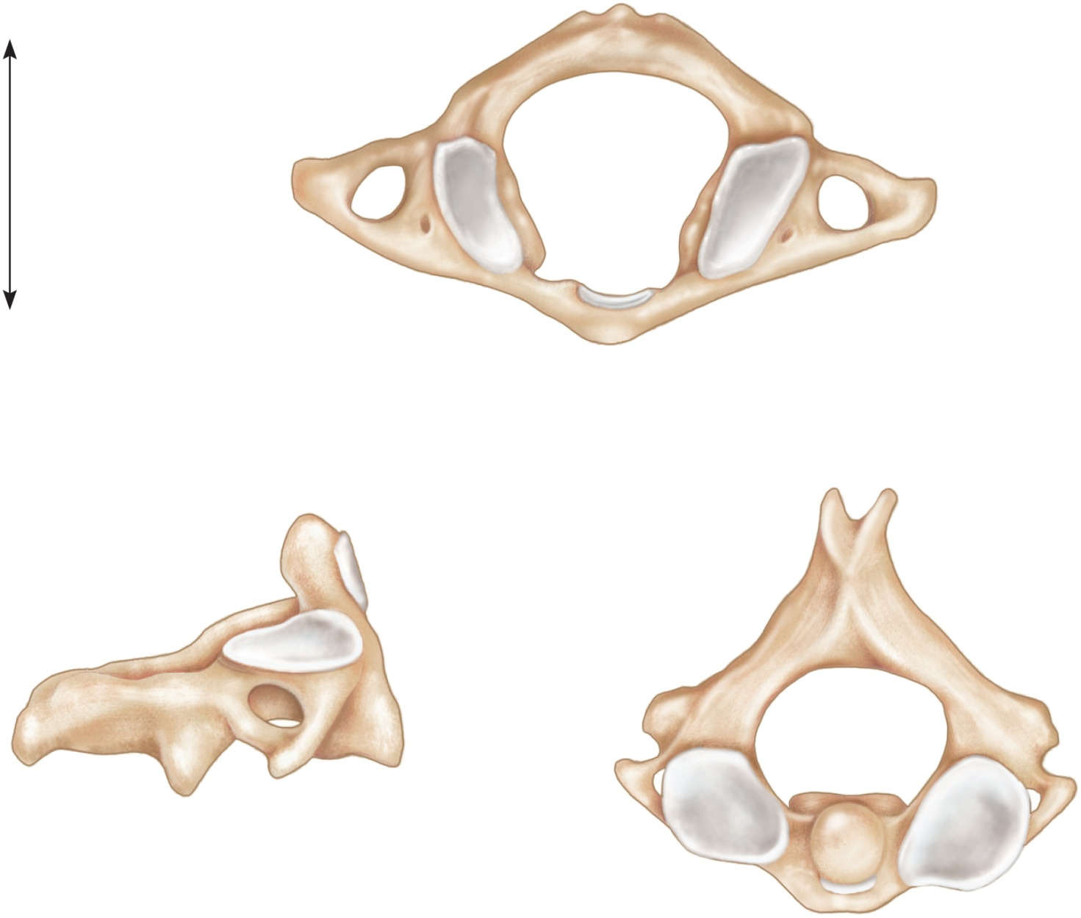
Posterior
Vertebral
foramen
Transverse
process
Anterior
Transverse
foramen
Atlas
(a)
Spinous
process
Dens
Spinous process
Transverse
foramen
Body
Transverse
process
Axis
Dens (odontoid
process)
(b)
(c)

Slide 11
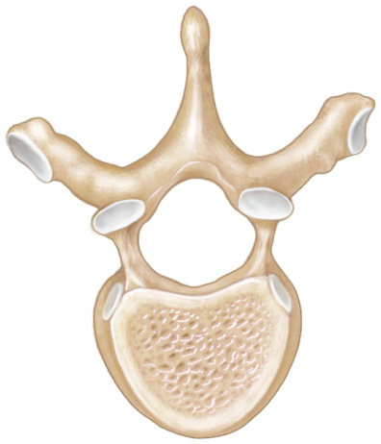
Spinous process
Transverse process
Vertebral foramen
Body
(b) Thoracic vertebra

Slide 12
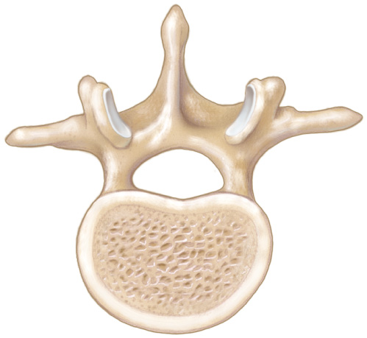
Spinous process
Transverse process
Vertebral foramen
Body
(c) Lumbar vertebra

Slide 13
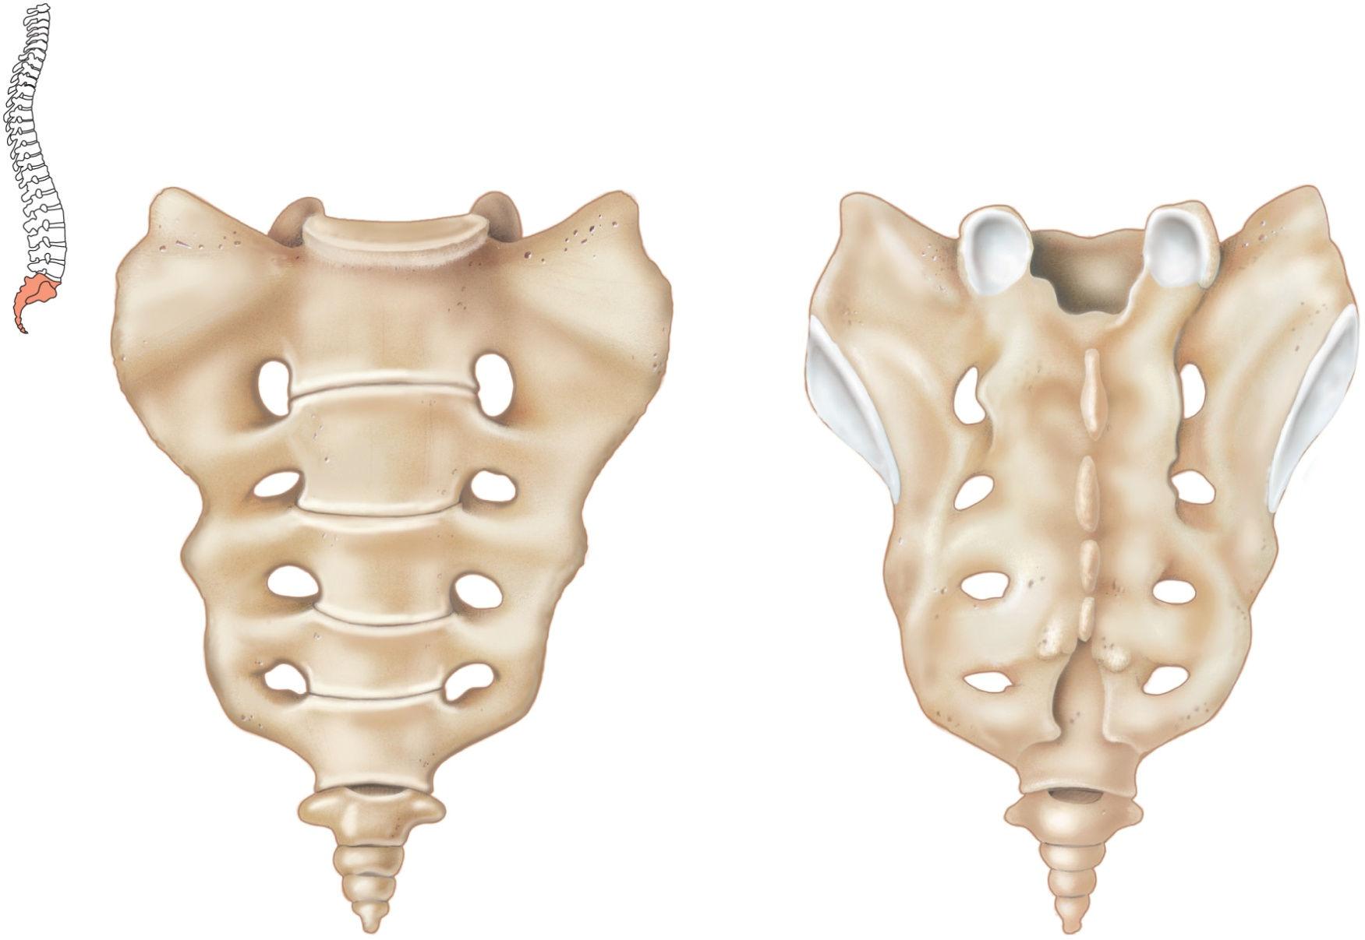
Sacrum
Median
Sacral Crest
Sacral
Foramen
Sacral
Foramen
Coccyx

Slide 14
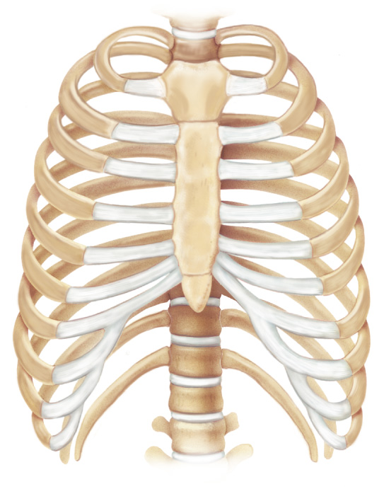
1
2
3
Manubrium
True ribs
4
5
Body
Sternum
6
7
Xiphoid process
8
Ribs
9
False
ribs
Costal
cartilage
10
1
1
12
Floating ribs

Slide 15
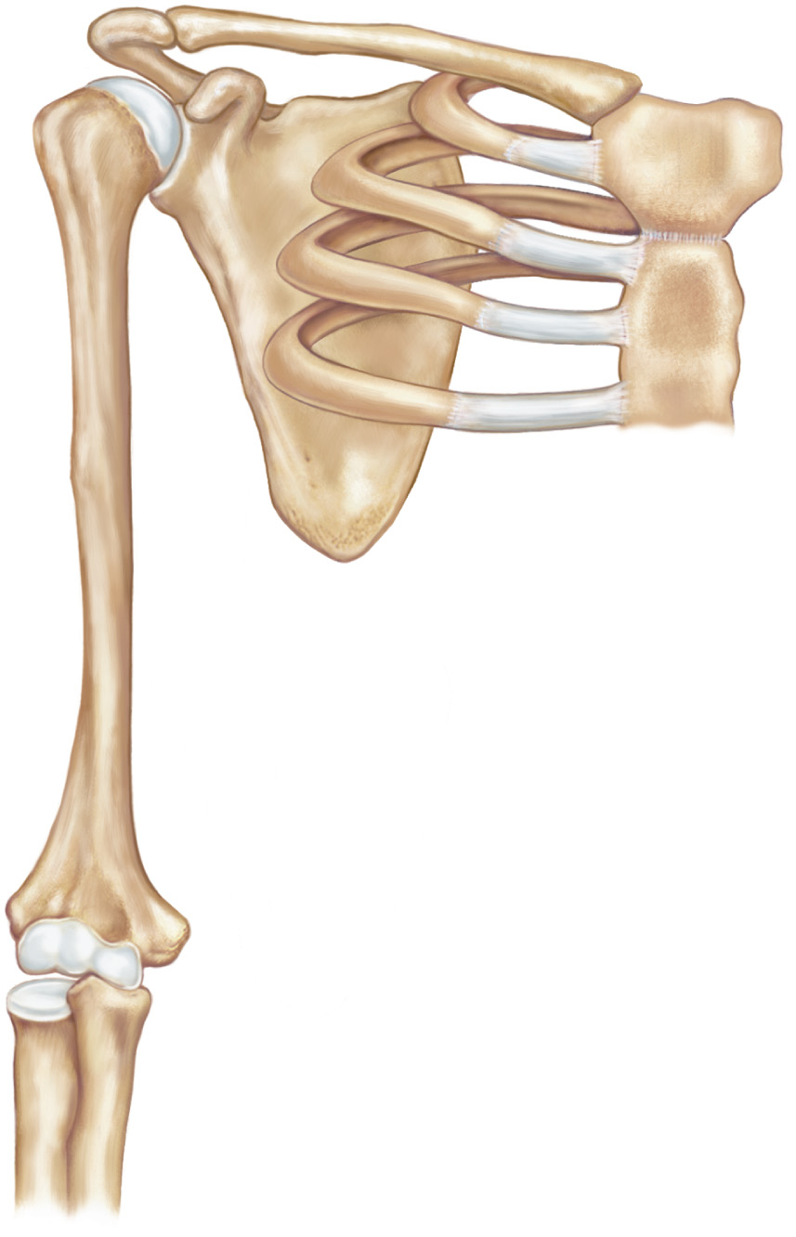
Acromial end
Acromion
process
Sternal end
Clavicle
Head of
humerus
Coracoid
process
Sternum
Costal
cartilage
Scapula
Rib
Humerus
Ulna
Radius

Slide 16
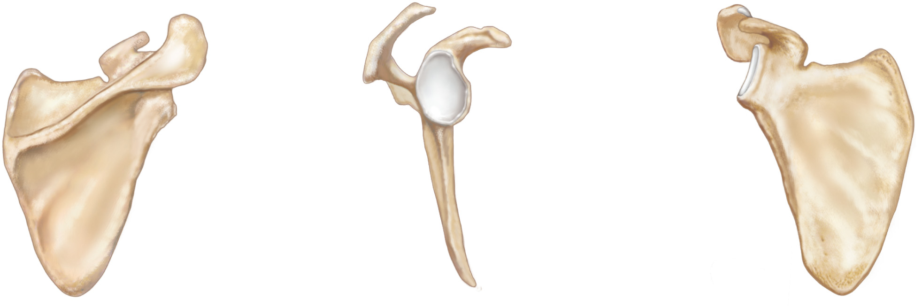
Coracoid
process
Acromion
process
Acromion
process
Coracoid
process
Spine
Glenoid
cavity
Glenoid
cavity

Slide 17
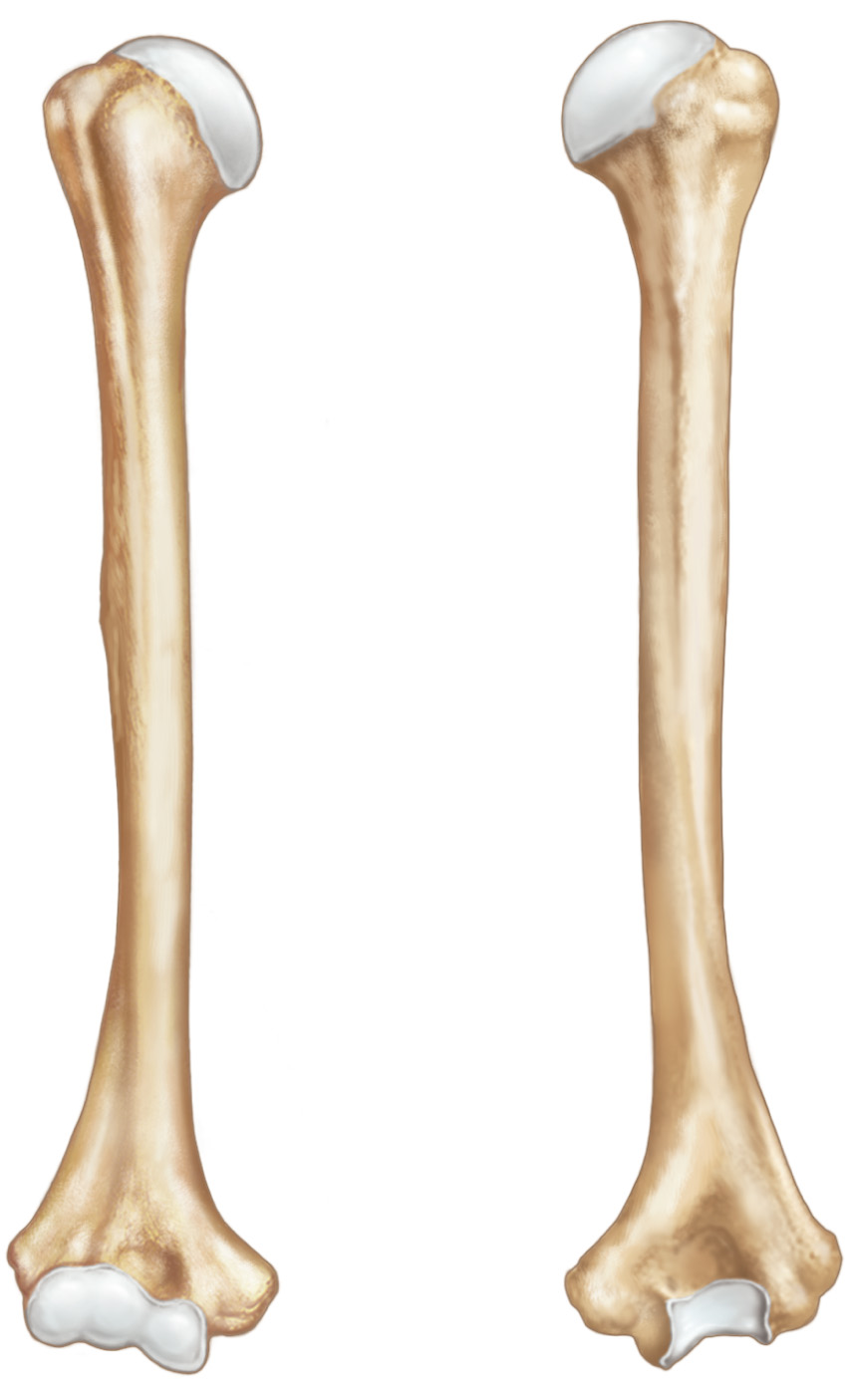
Greater tubercle
Head
Greater tubercle
Lesser tubercle
Deltoid tuberosity
Coronoid
fossa
Olecranon
fossa
(a)
(b)

Slide 18
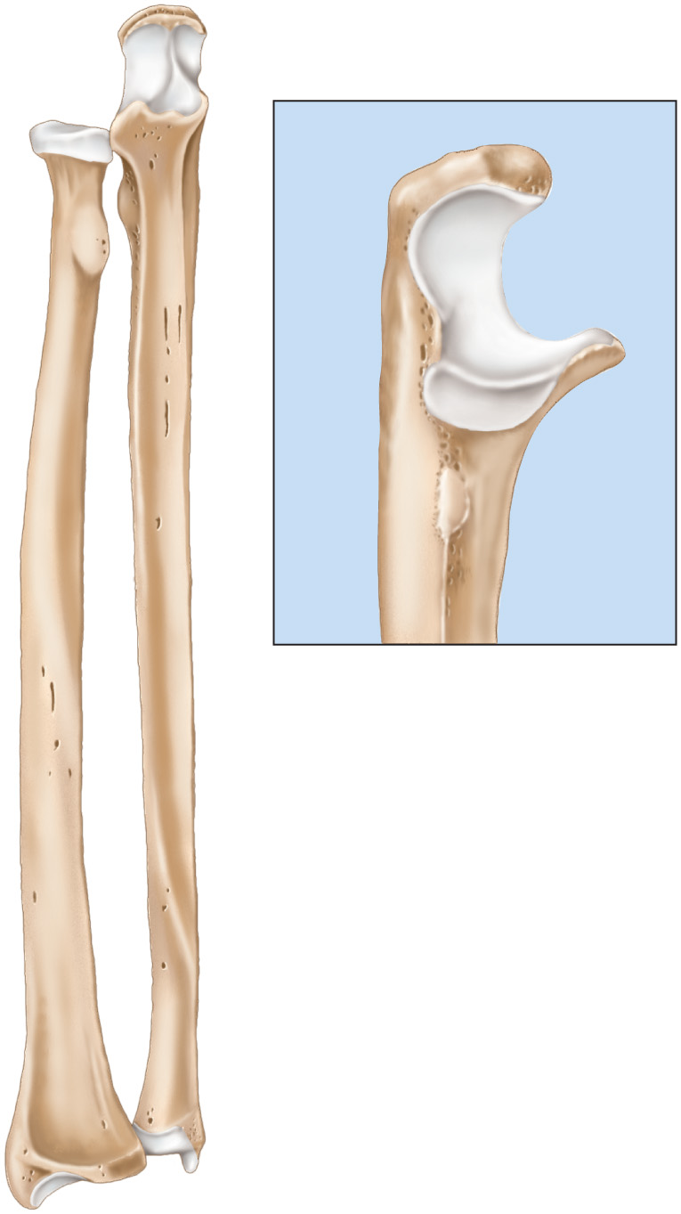
Olecranon
process
Coronoid process
Head of radius
Olecranon
process
Radial tuberosity
Coronoid
process
Radius
(b)
Ulna
(a)

Slide 19
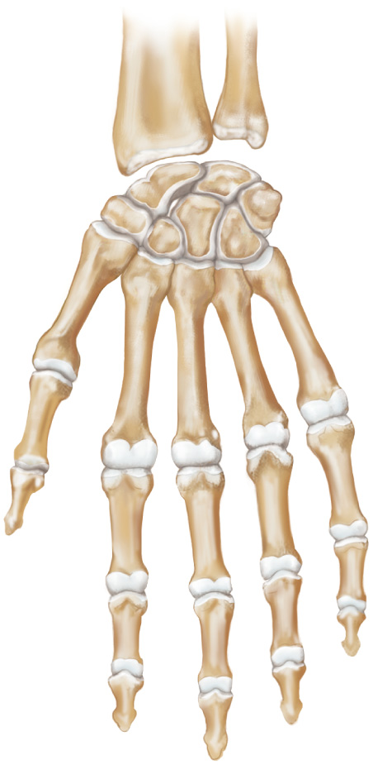
Radius
Scaphoid
Ulna
Capitate
Lunate
Trapezoid
Hamate
Trapezium
Triquetrum
Pisiform
Carpals
1
Metacarpals
2
5
3
4
Proximal
phalanx
Middle
phalanx
Phalanges
Distal
phalanx
(a)

Slide 20
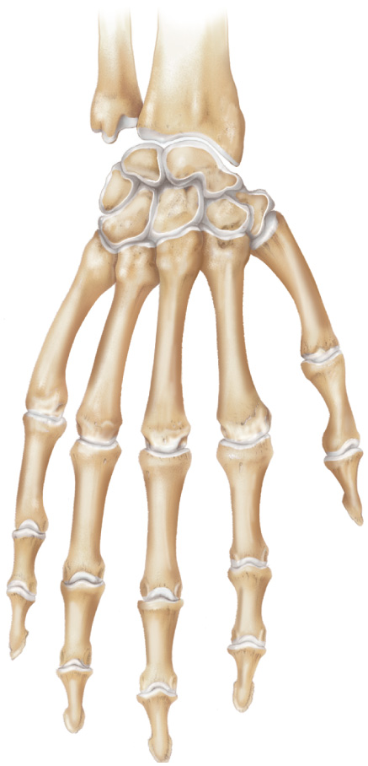
Radius
Ulna
Scaphoid
Lunate
Capitate
Hamate
Trapezoid
Triquetrum
Trapezium
1
5
4
2
3
Proximal
phalanx
Middle
phalanx
Distal
phalanx
(b)

Slide 21
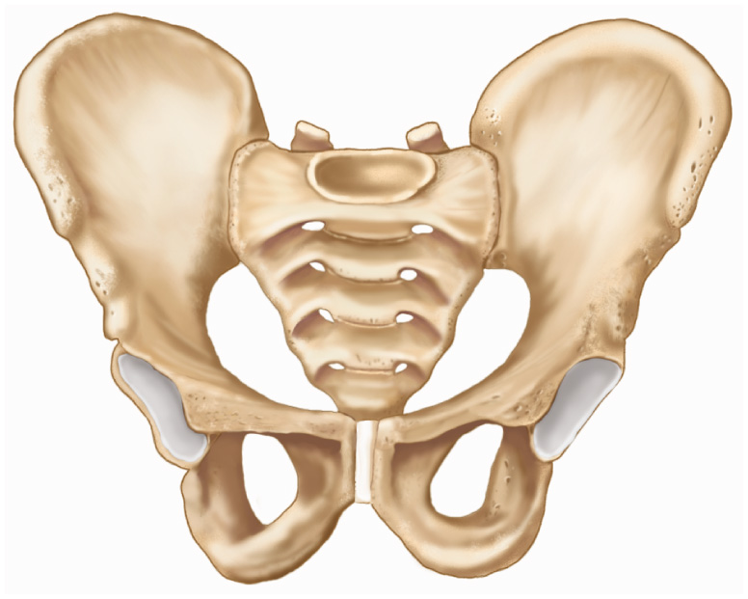
Ilium
Sacrum
Acetabulum
Pubis
Symphysis
pubis
Ischium

Slide 22
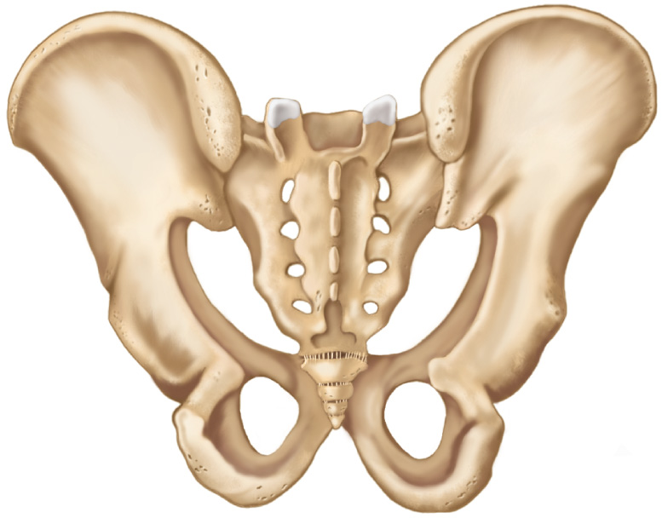
Ilium
Sacrum
Coccyx
Ischium
Obturator foramen
Pubis

Slide 23
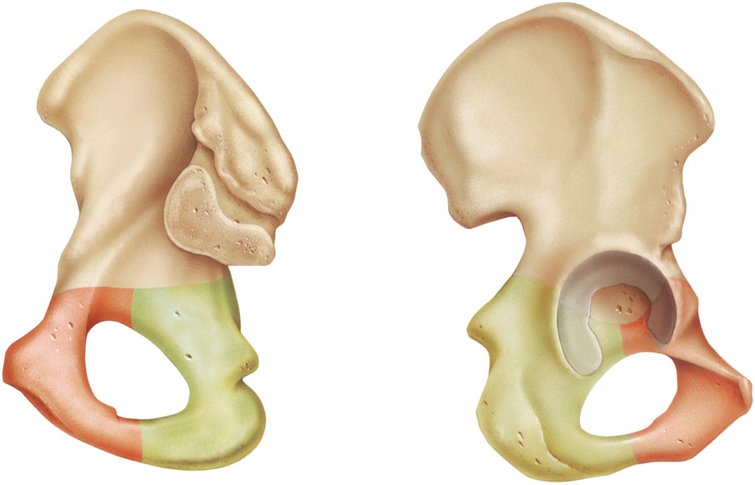
Ilium
Obturator
foramen
Acetabulum
Obturator foramen
Ischium
Ischial
tuberosity
Pubis

Slide 24
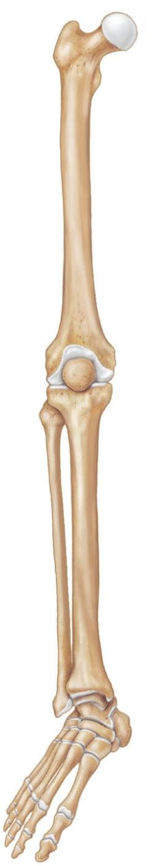
Femur
Patella
Fibula
Tibia
Tarsals
Metatarsals
Phalanges

Slide 25
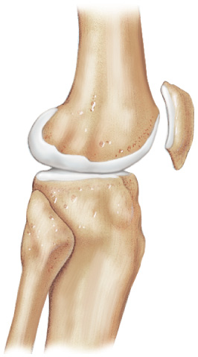
Femur
Patella
Fibula
Tibia

Slide 26
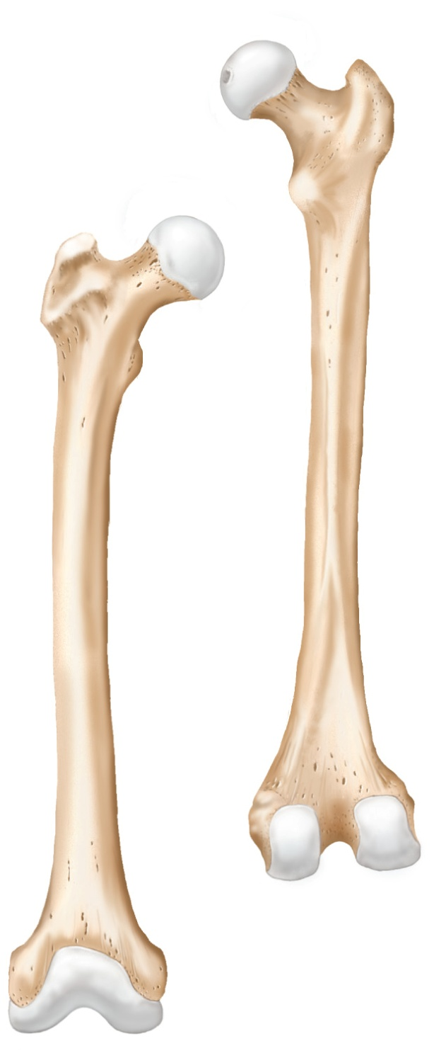
Fovea capitis
Head
Greater
trochanter
Lesser
trochanter
Linea
aspera

Slide 27
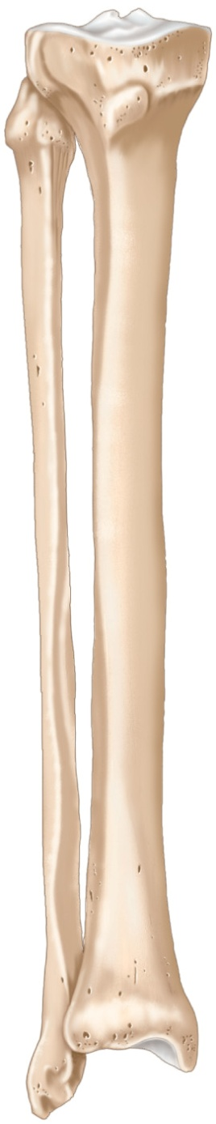
Head of
fibula
Tibial
tuberosity
Fibula
Tibia
Medial
malleolus
Lateral
malleolus

Slide 28
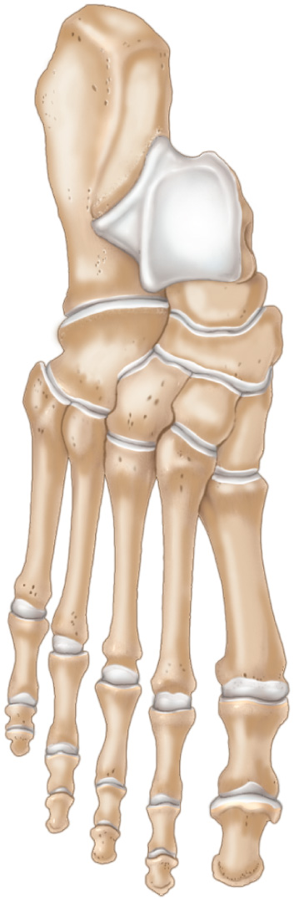
Calcaneus
Talus
Tarsals
Navicular
Cuboid
Lateral cuneiform
Intermediate cuneiform
Medial cuneiform
5
4
3
Metatarsals
2
1
Proximal phalanx
Middle phalanx
Distal phalanx
Phalanges

Slide 29
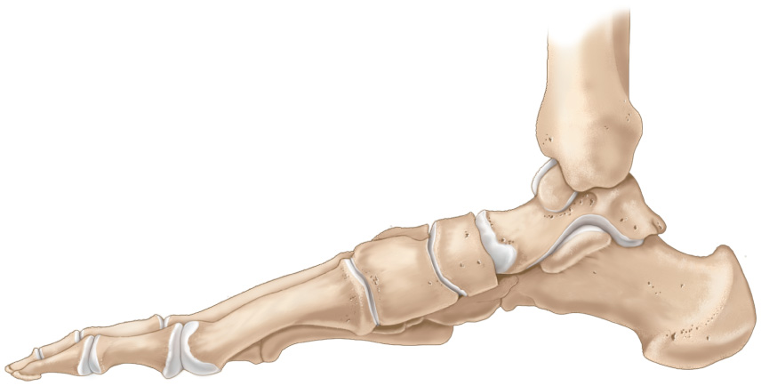
Fibula
Tibia
Talus
Medial
cuneiform
Navicular
Metatarsals
Calcaneus
Phalanges
Tarsals

